Slide 1
AP - The Advanced Placement Program
Information

Slide 2

What is the AP program?
AP stands for Advanced Placement. This program is designed to prepare students for university by creating courses that provide students with the learning and knowledge equivalent to a 1st year university course.
The courses are offered at the Gr. 12 level.
Students learn both the AP curriculum and the Ontario Curriculum.

Slide 3
What is the AP program?
In Gr. 12, the students’ final marks are based on their knowledge of the Ontario Curriculum, not the AP curriculum.
The mark on their report cards reflects their mark based on the Ontario curriculum.
Students are evaluated on the AP content in May of their gr. 12 year. This is when they write the standardized AP English Literature and Composition Exam.

Slide 4
What is the AP Program?
The English Department is offering the ENG3UE - the Pre AP course next year.
This course is the prep course for the Advanced Placement program.
If you take this course, you can take the ENG4UE course the following year.

Slide 5
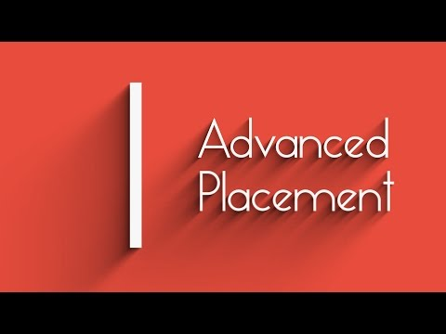
Advantages of taking AP English:
Taking the AP course will allow students the opportunity to:
Partake in enriched learning in English, and in reading that is “both wide and deep”, with texts ranging from the 16th to the 21st century.
Students develop critical thinking skills and literacy skills that can be applied in any discipline.
Potentially earn advanced placement at a university, depending on their exam score. The ENG4UE course is recognized as a first year English course by some universities.

Slide 6

REQUIREMENTS
You should have an interest in English in order to enroll in the course.
Your teacher will also provide feedback on whether or not you should take the course.
You may have to complete some summer reading in order to take the course

Slide 7

Why should you consider taking the AP course?
It allows you to challenge yourself.
It improves your time management skills.
It improves your literacy skills in all subject areas.
It broadens your university choices.
It allows you to explore future career choices and possibilities.

